Slide 1
Group Data Challenge
Parking Spot Recommendation
for the City of Zürich

Slide 2
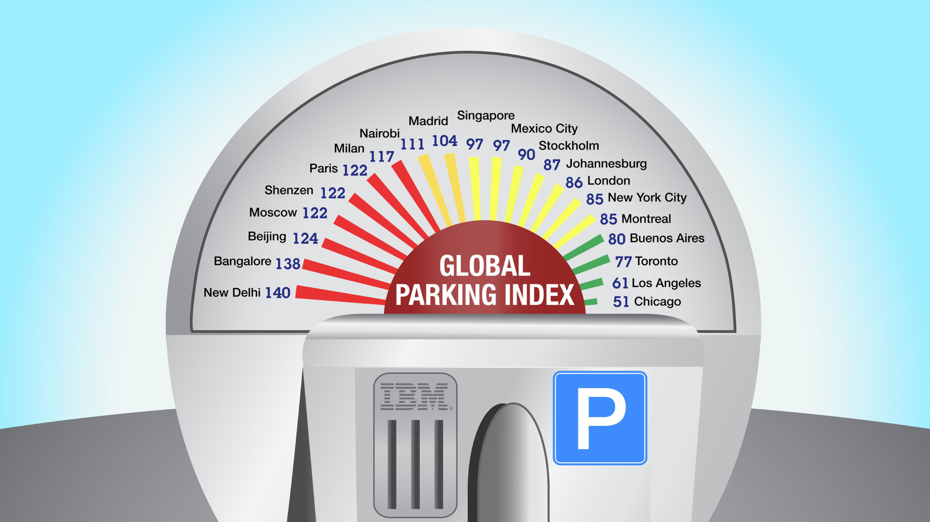
Finding Parking is hard in many major cities
IBM Global Parking Survey: Drivers Share Worldwide Parking Woes
8,042 commuters in 20 cities on six continents surveyed
Parking elusive worldwide; Over half report abandoning search for parking spot
Chicago reports the least amount of tickets for illegal parking; Bangalore tops the list
Drivers in New Delhi, Bangalore, Nairobi and Milan argue most over parking spaces

Slide 3
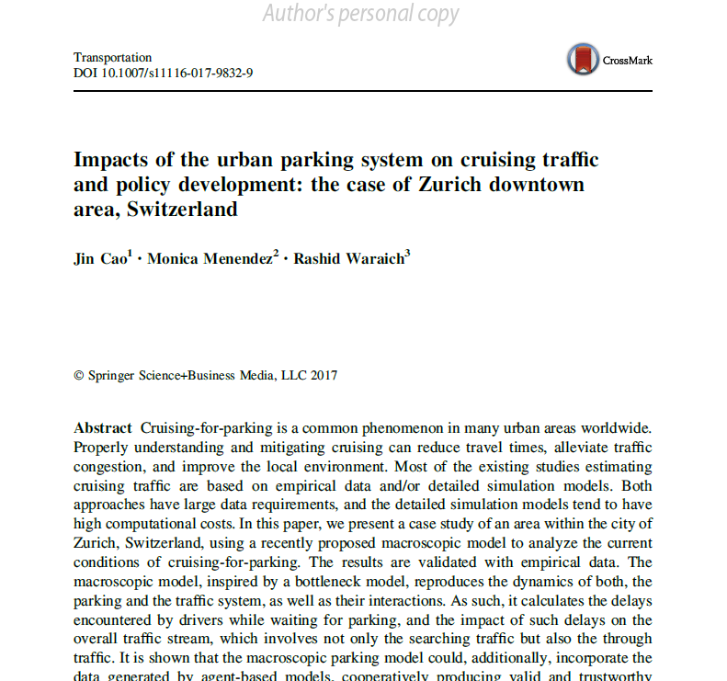
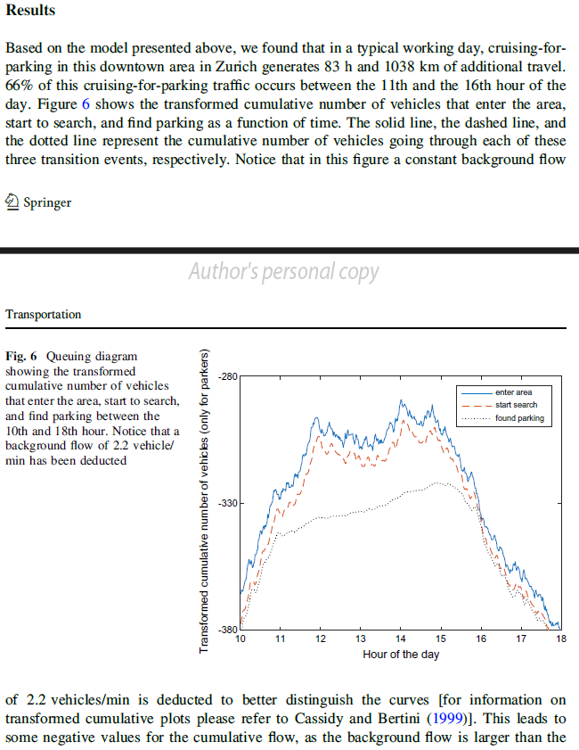
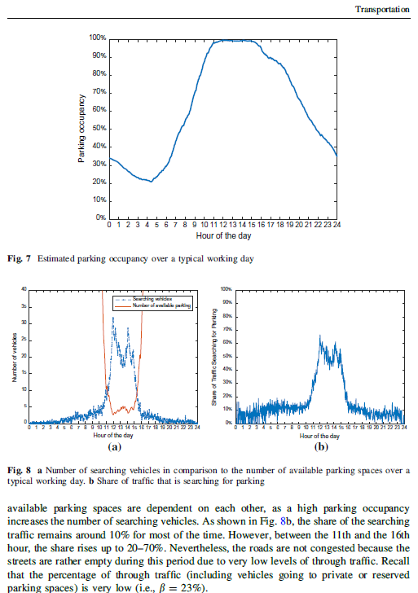
Zurich: 1038 km additional driving to find parking
In a typical working day, cruising-for-parking generates 83 h of additional travel time and, 1038 km of additional travel distance.
Worst condition corresponds to a maximum number of 30 searchers with an average search time of 13 min.

Slide 4
Wouldn’t it be nice if your smartphone knew where to find parking?
Let’s use data to tell you where to Park!
Stadt Zürich Open Data provides information for all street parking spots
Based on traffic counts, traffic noise, and other parameters we can suggest the most likely free parking spots
All this information is integrated into a convenient app

Slide 5
Live Demo Time!

Slide 6
Future Potential
Include more data
Incorporate real-time parking availability for parking garages (https://data.stadt-zuerich.ch/dataset/parkleitsystem)
Provide conditional rankings
Use user feedback gathered through the app to update and refine occupancy data
Use satellite images to estimate parking spot occupancy

Slide 7
References
Data Sources
Stadt Zürich Open Data (https://data.stadt-zuerich.ch/)
UrbanDataLab AG (http://urbandatalab.ch/)
Articles
Cao, J., Menendez, M., & Waraich, R. (2019). Impacts of the urban parking system on cruising traffic and policy development: the case of Zurich downtown area, Switzerland. Transportation, 46, 883-908.
Drouyer, S., & de Franchis, C. (2020). Parking occupancy estimation on sentinel-1 images. ISPRS Annals of the Photogrammetry, Remote Sensing and Spatial Information Sciences, 2, 821-828.

